Slide 1

CMP302: Algorithms
Lecture 02: Algorithms Analysis
Mayada Mansour Hadhoud
Computer Engineering Department
Cairo University
Fall 2014

Slide 2
Time efficiency of nonrecursive algorithms
General Plan for Analysis
Decide on parameter n indicating input size
Identify algorithm’s basic operation
Determine worst, average, and best cases for input of size n
Set up a sum for the number of times the basic operation is executed
Simplify the sum using standard formulas and rules.

Slide 3
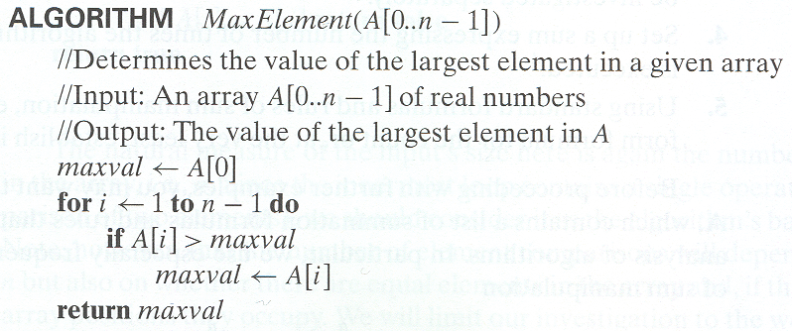
Example 1: The Largest Element
T(n) = Σ1≤i≤n-1 (1) = n-1 = Θ(n) comparisons

Slide 4
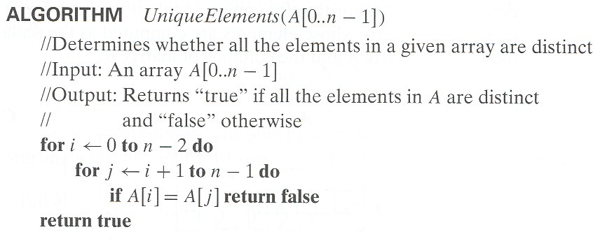


Example 2: Element uniqueness problem

Slide 5
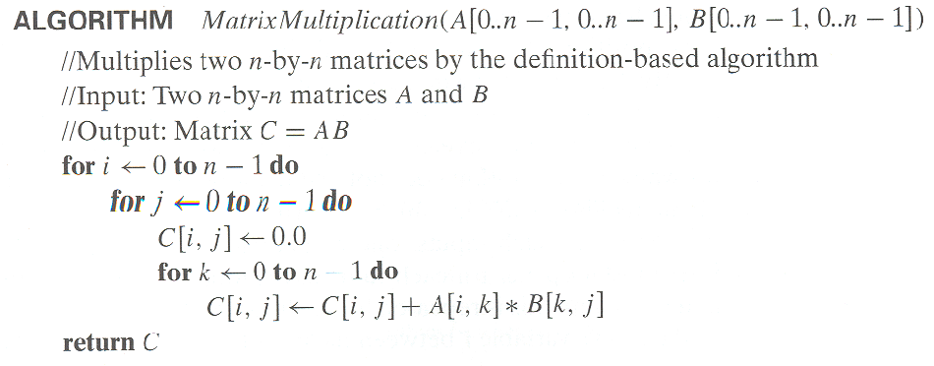
Example 3: Matrix multiplication
T(n) = = Θ( ) multiplications
Ignored addition for simplicity

Slide 6
Time efficiency of recursive algorithms
Decide on a parameter indicating an input’s size.
Identify the algorithm’s basic operation.
Check whether the number of times the basic op. is executed may vary on different inputs of the same size. (If it may, the worst, average, and best cases must be investigated separately.)
Set up a recurrence relation with an appropriate initial condition expressing the number of times the basic op. is executed.
Solve the recurrence (or, at the very least, establish its solution’s order of growth) by backward substitutions or another method.

Slide 7
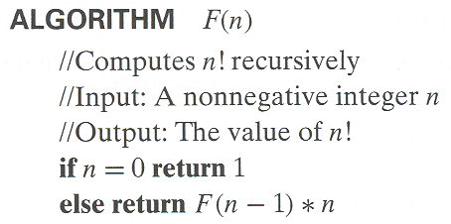
Example 1 : Factorial: Recursive Algorithm
Recursive definition of n!: F(n) = F(n-1) ∗ n for n ≥ 1 and
F(0) = 1
Input size = n, basic operation “multiplication”
The stopping condition is n=0
Recurrence relation = M(n)=M(n-1)+1 M(0)=0

Slide 8
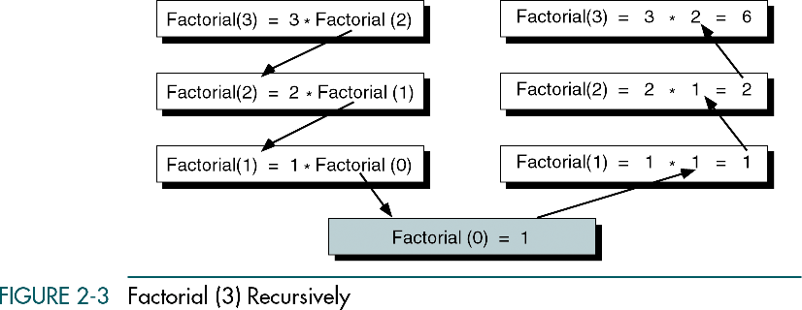
Solving the recurrence for M(n)
M(n) = M(n-1) + 1, M(0) = 0 (no multiplication when n=0)
M(n) = M(n-1) + 1
= (M(n-2) + 1) + 1 = M(n-2) + 2
= (M(n-3) + 1) + 2 = M(n-3) + 3
…
= M(n-i) + i
= M(0) + n
= n
The method is called
backward substitution.

Slide 9
Important recurrence types
One constant operation (linear): reduces problem size by one
T(n)=T(n-1)+c T(1)=d
solution: T(n)=c*(n-1)+d
A pass through input (quadratic): reduces problem size by one
T(n)=T(n-1)+c*n T(1)=d
solution: T(n)=c*(n*(n+1)/2 - 1)+d

Slide 10
Important recurrence types
One constant operation (log): reduces problem size by half
T(n)=T(n/2)+c T(1)=d
solution: T(n)=c*log(n)+d
A pass through input (nlogn): reduces problem size by half
T(n)=2*T(n/2)+c *n T(1)=d
solution: T(n)=c*nlog(n)+d*n

